Slide 1
Team Transfer
Mid-Quarter Presentation
Hyeongju Choi, Ritika Gupta, Jasmine Hawkins,
Sharon Heung, YoonBo Shim

Slide 2
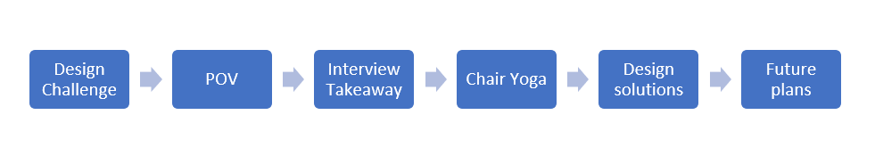
Overview

Slide 3
Design Challenge
When Carolee sits down, she “drops” or “falls into place, which can be uncomfortable and dangerous.
How can we design a tool to support safer transfers that reduce reliance on expensive devices and family support?

Slide 4
POV
“Carolee needs to safely transfer from standing to sitting because she wants to feel independent and empowered”

Slide 5
Interview Takeaways
Inclusion Body Myositis: inflammatory condition of muscles
Freedom Chair, Power toilet, Walker, Wheelchair, Transfer Board
Her primary concern: losing arm strength
Tom: for the future, we are “working toward immobility”
Focus on core strength

Slide 6
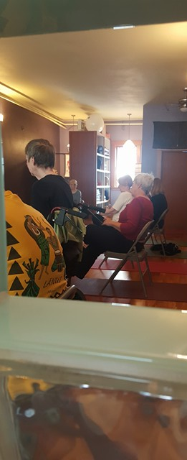

Chair Yoga
Carolee has remarkably good core strength
Primary weakness in leg and arm muscles
Heavy reliance on Tom’s assistance
Carolee and Tom at Chair Yoga

Slide 7
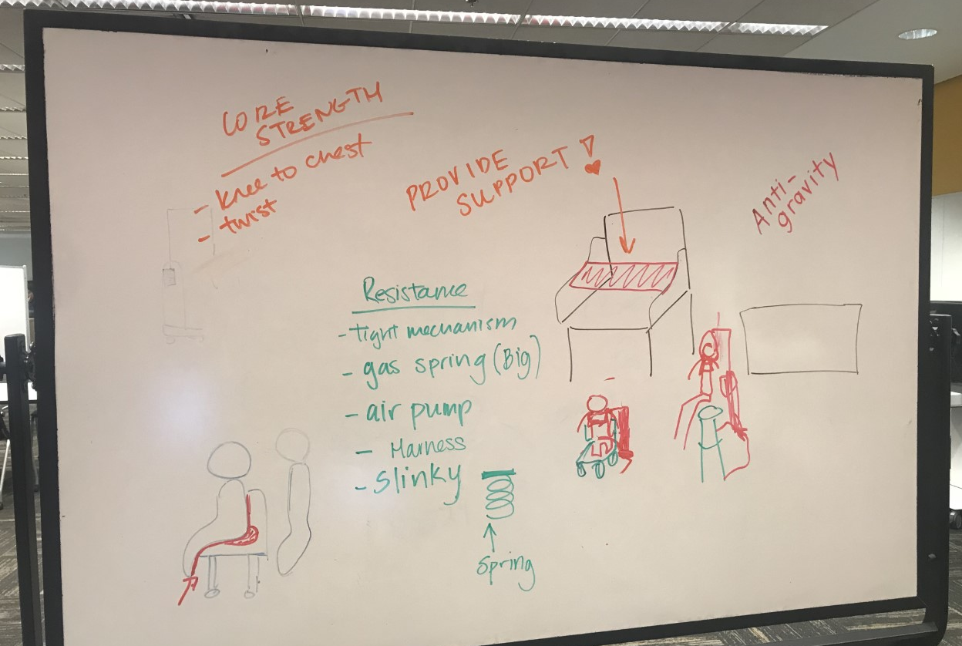
Design Solution Brainstorm

Slide 8
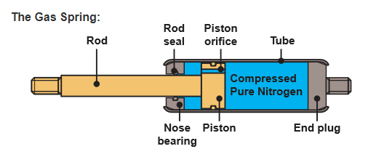
Gas Spring
Compressed nitrogen gas can provide force against weight.
Generally used for Height adjustable chairs, automobiles(struts), medical, and aerospace applications
Shock relief during the transition(from standing to sitting)
Lockable at any height
Inexpensive

Slide 9
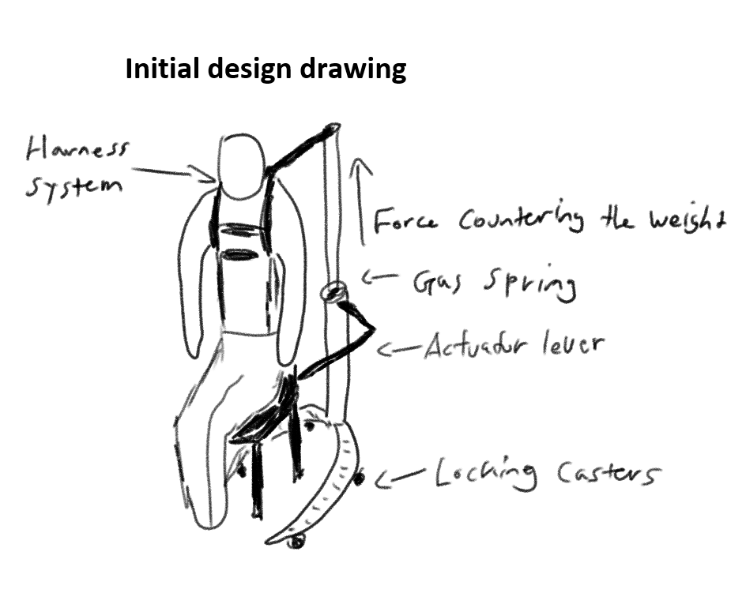
Gas spring Initial Design
Combine harness system with a gas spring

Slide 10
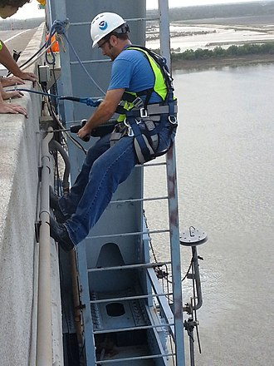
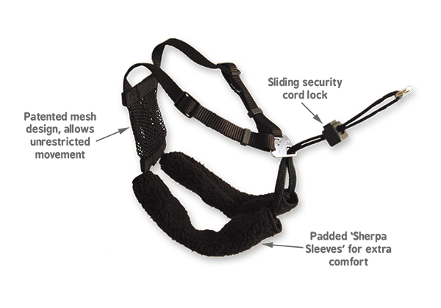
Harness Mechanism

Slide 11
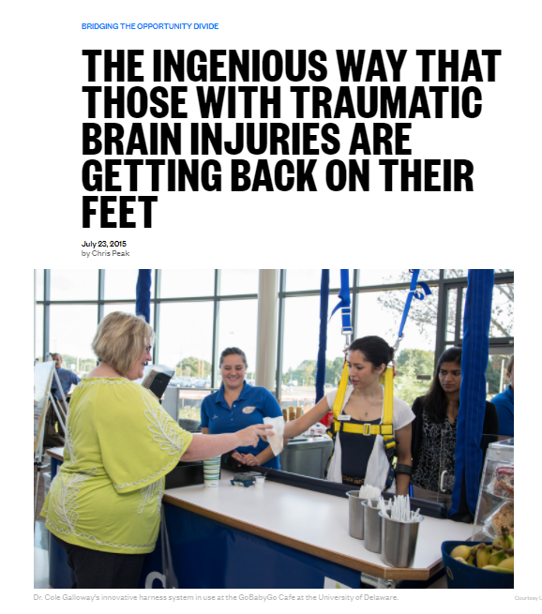
Harness System
Using a harness system to hold her weight
Maximizing core strength
Taking advantage of the weight of the wheelchair itself

Slide 12
Future Plans & Goals
Keep on designing + researching!
11/9 Comotion 3D printing workshop
11/24 2nd meet up with Carolee
Present ideas and research findings
Possibly ask Carolee to rank the ideas

Slide 13
References
http://nationswell.com/cole-galloway-harness-system-enter-workforce/
We thank Dr. Steele, Carolee, and Tom for aiding us with our project.

Slide 14
QUESTIONS?

